Slide 1
Grant Issues: Informatics
Ran Li
8-5-22
Issues: #3, #5

Slide 2
Overview
Introduction to our infrastructure work at SALURBAL
Decode request for ‘informatics infrastructure’ language
Present proposal for ‘informatics infrastructure’

Slide 3
SALURBAL: what we wanted to do
BR
BRR
MX
MX
CL
CL
PE
PE
Input:
raw data (census/survey…ETC) from 11 countries in Latin-America
Output:
Harmonized datasets from which we can do analysis that spans across countries

Slide 4
SALURBAL: What we did
Mortality (Jane)
Methodology was excellent across working groups
Lack of infrastructure standards across working groups: data format, variable naming conventions, codebook format, codebook content, file structures…
Income (Jeff)
Health (James)

Slide 5
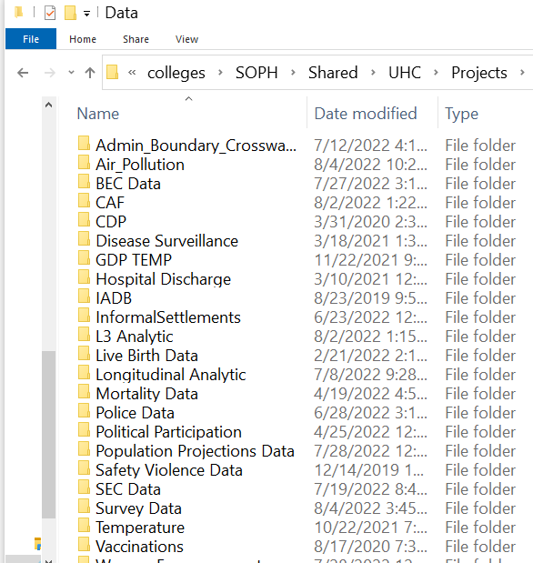
SALURBAL: What we did
Mortality (Jane)
Methodology was excellent across working groups
Lack of infrastructure standards across working groups: data format, variable naming conventions, codebook format, codebook content, file structures…
The final output was stored in separate folders created by each working group
This was the informatics infrastructure Years 1-4.
Lack of structure and accessibility created bottlenecks
Income (Jeff)
Health (James)

Slide 6

🤕 #1 Lack of transparency to data available
What data is available?
Do I have to click every folder individually and check every data file?
Users
(researchers)

Slide 7

🤕 #2 Data access is inefficient
Mortality (Jane)
Can I have income and mortality data?
Income (Jeff)
Health (James)
SALURBAL
(staff)
Users
(researchers)

Slide 8
🤕 #2 Data access is inefficient
Mortality (Jane)
Manually pull income data
Manually pull mortality data
Manually pull income metadata
Manually pull mortality metadata
Manually wrangle and merge data
Manually wrangle and metadata
Manually QC
Manually send merged data to user
Income (Jeff)
Health (James)
SALURBAL
(staff)
Users
(researchers)

Slide 9
If data was in one data structure… I could:
Do a systematic EDA
Reuse unit testing across all the data to standardize QC!
Write a script to automate with data transfer to researchers!’
Make parameterized reports for each city…
ETC
🤕 #3 No big picture
Mortality (Jane)
Income (Jeff)
Health (James)
SALURBAL
(staff)

Slide 10
SALURBAL: what are doing now
Mortality (Jane)
Design a SALURBAL wide informatics standard (variable naming, data format, metadata format) applied at the work group level.
Income (Jeff)
Health (James)

Slide 11
SALURBAL: what are doing now
Mortality (Jane)
Design a SALURBAL wide informatics standard (variable naming, data format, metadata format) applied at the work group level.
Build a unified dataset with automated testing to enforce strict standards
Income (Jeff)
Health (James)

Slide 12


SALURBAL: what are doing now
Mortality (Jane)
Design a SALURBAL wide informatics standard (variable naming, data format, metadata format) applied at the work group level.
Build a unified dataset with automated testing to enforce strict standards
Create a user-friendly data portal to access/download data, metadata and reproject outputs.
Income (Jeff)
Health (James)

Slide 13
SALURBAL: Insights gained
Well designed infrastructure matters!
Version control + GitHub to manage complex codebases across collaborators
Thinking web-first! Building machine interfaces for data require FAIR data.
Efficient end-to-end pipelines (raw data to output) to allow staff to focus on the research and gives collaborators faster access to data
Systematic enforcement of QC standards to improve data quality
Its possible that your methodology and statistics are excellent, but your project may still be hampered by informatics bottlenecks.

Slide 14
SALURBAL: Lessons learned
Well thought out and built informatics infrastructure matters!
Version control + GitHub to manage complex codebases across collaborators
Thinking web-first! Building machine interfaces for data require FAIR data
Efficient end-to-end pipelines (raw data to output) to allow staff to focus on the research and gives collaborators faster access to data
Systematic enforcement of QC standards to improve data quality
If your methodology and statistics are excellent your project may still be hampered by informatics bottlenecks.
Questions for future projects
What would things have been like if we prioritize efficient infrastructure at Day 1 instead of Year 5?
How can we reimagine SALURBAL?
What does ‘high-capacity informatics infrastructure’ mean to us?
Notes:
So before we go on to

Slide 15
Grant issues
Less straight forward issue
describing the first part (high-security-compliant, high-capacity informatics infrastructure suitable for data integration, storage, management, and sharing)
More straight forward issue (will tackle along the way)
Compare Azure and Amazon S3 data storage. Unknown scale.

Slide 16
Grant issues: break down
describing the first part (high-security-compliant, high-capacity informatics infrastructure suitable for data integration, storage, management, and sharing)
Describe high-capacity informatics infrastructure with the following features:
high-security-compliant
data integration
data storage
data management
data sharing
Notes:
Just adding a little structure to the list of buzzwords gives me… read the slide
->

Slide 17
Grant issues : break down
describing the first part (high-security-compliant, high-capacity informatics infrastructure suitable for data integration, storage, management, and sharing)
Describe high-capacity informatics infrastructure with the following features:
high-security-compliant == securely/HIPAA compliance/careful with HPI
data integration == able to handle complex data inputs from various sources
data storage == has scalable/performance storage
data management == able to clean, transform and analyze
data sharing == easily distribution data or results
Notes:
Well the features are pretty straight forward and things I think we are all relative comfortable with.
- security
- integration
- storage
- management
- sharing
But the one key word that still bugs me is informatics. I am going give a really high level description of informatics in hopes that it better helps us understand what the funding committee is really asking us.

Slide 18
Grant issues: informatics
What is informatics?
An applied definition could be “Informatics is a window into … the interplay of people and technology” - UCI's informatics home page
An applied example at Dornsife this could be the interplay between statisticians and software/computers. We use computers to make store/share data (as oppose to writing it down), to do computations (opposed to calculating by hand), to share findings (instead of draw plots). Informatics is the study of how we use technology to do what we do!
Notes:
…
Given this context lets return to the original request from the funding committee.

Slide 19
Grant issues: the big question
Through asking us to describe high-capacity informatics infrastructure what funding committee really means is..
If this grant is funded, you will need to use computer technology to carry out your proposed grant objectives ... what is your plan to use computing safely, effectively and efficiently?
Notes:
…
So I th

Slide 20
Grant issues: the big question
Through asking us to describe high-capacity informatics infrastructure what funding committee really means is..
If this grant is funded, you will need to use computer technology to carry out your proposed grant objectives ... what is your plan to use computing safely, effectively and efficiently? What best practices will be your core values? What modern technologies will you leverage?
IMO: A thorough answer is not simple. Not just we will use Azure service X for this or AWS service for Y.
Notes:
…

Slide 21
Proposal: how have others answered it?
An informatics infrastructure for patient safety and
evidence-based practice in home healthcare
Bakken S, Hripcsak G. An informatics infrastructure for patient safety and evidence-based
practice in home healthcare. J Healthc Qual. 2004 May-Jun;26(3):24-30.
doi: 10.1111/j.1945-1474.2004.tb00492.x. PMID: 15162630.
Abstract
The informatics infrastructure for patient safety and evidence-based practice (EBP) in home healthcare comprises data acquisition methods, healthcare standards including standardized terminologies, data repositories and clinical event monitors, data-mining techniques, digital sources of evidence, and communication technologies. Although the components of an informatics infrastructure are available and applications that bring these components together to promote patient safety and enable EBP have demonstrated positive or promising results in the acute care setting, a number of challenges hinder implementation in home healthcare. Resolution of these challenges requires commitment and collaboration among key stakeholders.

Slide 22
Proposal: components
In drafting a response, I am splitting things into three sections:
Core values and best practices
Hardware recommendations
Software recommendations

Slide 23
Proposal: Core values
Informatics competencies
Version control + online Git platform to manage complex codebases across collaborators
Offer informatics training for project on-boarding of collaborators.
Web-first thinking
Design a machine interface (web application) for data security, integration, storage, management and distribution
Web applications are logical they require FAIR data
Automate as many tasks as possible
Regression testing: translate data hiccups to unit tests
Efficient end-to-end pipelines (raw data to output) to allow staff to focus on the research and gives collaborators faster access to data
Can be easily translated to a public facing product at the end
Include engineers in high level talks
A successful project requires many hats. Empower informatics focused engineers to develop solutions that free up statisticians to focus on the research!

Slide 24
Proposal: Hardware Context
The rise of commercial cloud infrastructure platforms such as Google Cloud Platform, Amazon Web Services (AWS) and Microsoft Azure has revolutionized how businesses are run. These platforms offer similar portfolio of services including storage, computing, web hosting, serverless computing. Here is how they became commercially viable
Vertical integration: before different services were at different companies. Now they are all in one platform
Massively scalable: Designed for enterprise level data
Consumption-based costs: pay as you go. No upfront investment needed. No infrastructure staff needed for maintenance.
Notes:
Hardware: The rise of **commercial cloud infrasture platforms** such as Google Cloud Platform, Amazon Web Services (AWS) and Microsoft Azure has revolutionized how businesses are run. Both these platforms offer similiar portfolio of services including storage, computing, web hosting, serverless computing. These services have been around before but AWS and Azure did a few things to make it commercial **viable** product:
Vertical integration Each platform e.g. Azure has all the tech needed to build a business (storage, computing, web hosting ... ETC ) where as before you go to different companies for different things. such as goDaddy to host a website then hire a IT team to maintain a local server on premise. Now you can fire your IT team and do everything on Azure.
Massively scalable The infrasture are designed to handle enterprise scale data requirements (imagine storage infrastrature for petabytes -10^9 GB0- scale for a company like youTube). This is particularly attract for start ups who have low data volume initially but will scale up; they can trust that if they build their business infrastructure on Azure this will be able to handle increased data scales as they grow.
Consumption-based costs cost is pay as you go based on how much data or computing you use. This has two implications: firstly, in the short term start ups dont need to have large up-front investments hardware and secondly, in the long term businesses don't need staff whos role is maintain hardware infrastructure. Again since the service is designed for enterprise scale constomers; most of the scale of data for academia is smaller and we get great value with consumption-based costs.

Slide 25
Proposal: Hardware Context
Vertical integration: before different services were at different companies. Now they are all in one platform
Massively scalable: Designed for enterprise level data
Consumption-based costs: pay as you go. No upfront investment needed. No infrastructure staff needed for maintenance.
We are a start up… not sure of the scale of the data requirements we will face in 6 months… in 5 years.
But cloud infrastructure is designed so that we can feel safe to build our informatics there and trust that it will scale as the project develops.
Notes:
Hardware: The rise of **commercial cloud infrasture platforms** such as Google Cloud Platform, Amazon Web Services (AWS) and Microsoft Azure has revolutionized how businesses are run. Both these platforms offer similiar portfolio of services including storage, computing, web hosting, serverless computing. These services have been around before but AWS and Azure did a few things to make it commercial **viable** product:
Vertical integration Each platform e.g. Azure has all the tech needed to build a business (storage, computing, web hosting ... ETC ) where as before you go to different companies for different things. such as goDaddy to host a website then hire a IT team to maintain a local server on premise. Now you can fire your IT team and do everything on Azure.
Massively scalable The infrasture are designed to handle enterprise scale data requirements (imagine storage infrastrature for petabytes -10^9 GB0- scale for a company like youTube). This is particularly attract for start ups who have low data volume initially but will scale up; they can trust that if they build their business infrastructure on Azure this will be able to handle increased data scales as they grow.
Consumption-based costs cost is pay as you go based on how much data or computing you use. This has two implications: firstly, in the short term start ups dont need to have large up-front investments hardware and secondly, in the long term businesses don't need staff whos role is maintain hardware infrastructure. Again since the service is designed for enterprise scale constomers; most of the scale of data for academia is smaller and we get great value with consumption-based costs.

Slide 26
Proposal: Hardware Context
AWS vs Azure is like Kellogg's vs General Mills.
Azure vs Amazon S3 this is not a valid comparison is like comparing Kellogs to a particular oatmeal made from General Mills. Proper comparison Azure block storage is comparable to Amazon S3.
My intuition for making a recommendation without knowing specific data requirements. As Nora pointed out we have no idea how much data, how much or what access will look like. Assuming the AWS and Azure are price comparable and both able to configured to be HIPAA compliant (Azure doc, AWS docs). I think the decision really comes down to experience.

Slide 27
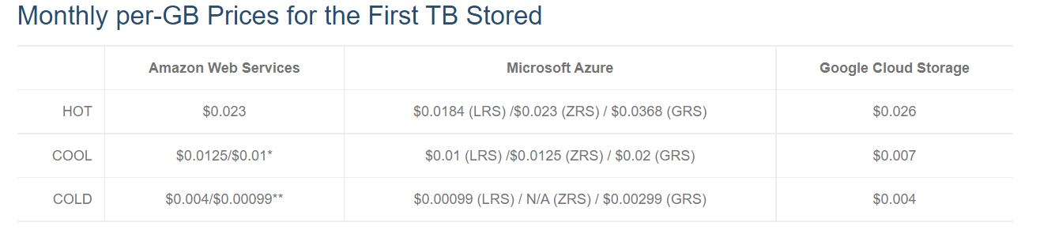
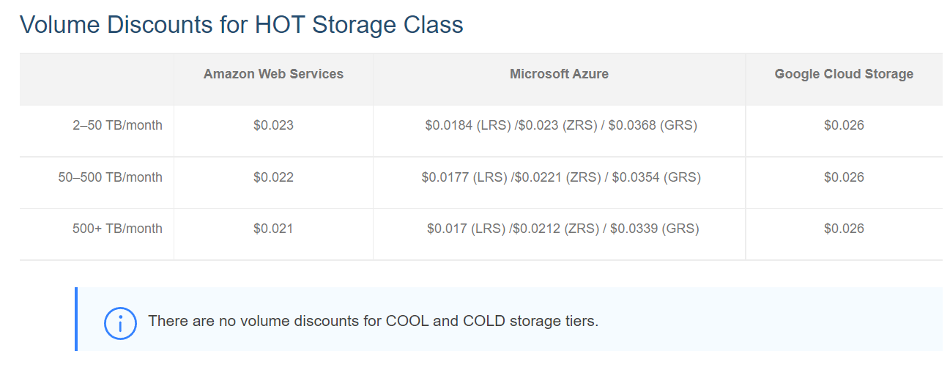

Slide 28
Proposal: Hardware
Platform: Azure
Take away: Specific services and cost depend on data requirements but we could trust that it will be competitive, performant and scalable.

Slide 29
Proposal: Software
Scientific and technical publishing: Quarto
Data science tools: such as the Tidyverse are well maintained open source tools that are not only easy to learn but also extremely powerful.
Web development:
Take advantage of user friendly and scalable front end frame works opens sourced by tech companies such as React.js and Next.js
Light weight tech stacks through serverless technologies (AWS lambda or Azure functions).
Codebase management: research is code lets organize it well and have infrastructure in place for remote collaboration. Git for version control and GitHub as a online git platform
Notes:
These are things that are relatively new and not used at Dornsife but would be great tools to build informatics infrastructure. It really is a case of slowing down to speed up but its great to do this at the start of a big project.

Slide 30
Thanks

